Slide 1

Digital Twin Implementation of Industrial IoT (Industry 4.0)
Syed Imran Ahmed
1604-19-744-013
M.E – Digital System II year
SEM -IV
Under the guidance of
Dr. Mohammed Arifuddin Sohel
Professor and Head, ECED

Slide 2
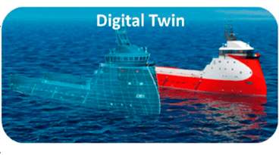
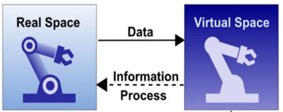
Contents:
Abstract
Introduction 4.0
Introduction to
Digital Twins
Literature Survey
Problem Statement
Objective
4 DoF robotic Arm
Conveyor Belt system
Shape Recognition
Digital twin simulation
Conclusion and Future Scope
References

Slide 3
Abstract:
IoT device operates by interacting with sensors and actuators and other IoT devices during its operation.
The IoT lifecycle can be improved by creating a digital twin of a physical object and ensuring information feedback and feed-forward flows between physical and virtual entities.
Digital Twins are a new mechanism to manage IoT devices and project aims at implementation of IoT in Industrial setup called as Industrial IoT or Industry 4.0
This project takes the case study of a commonly used Industry automation setup consisting of conveyor belt and robotic arm for implementation of Machine learning based object sorting using a digital twin.

Slide 4
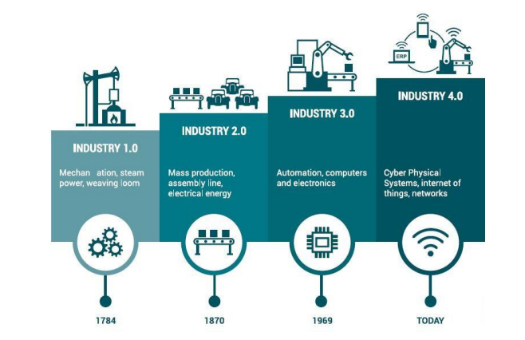
Industrial IoT or Industry 4.0

Slide 5
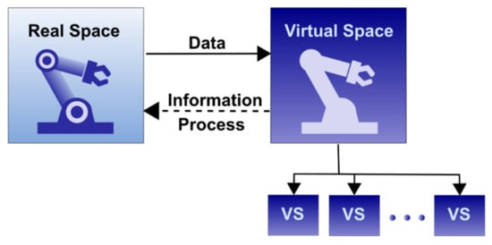
Digital Twin Technology
Digital Twins are the virtual counterparts of the physical objects also known as assets
These digital assets can be created using simulation tools like Solid works / Unity even before an asset is built physically.
Data collected from various physical sources is used to get insights from analytics software and AI algorithms are applied to create models.
The digital twin will act as a live model of the physical equipment.

Slide 6
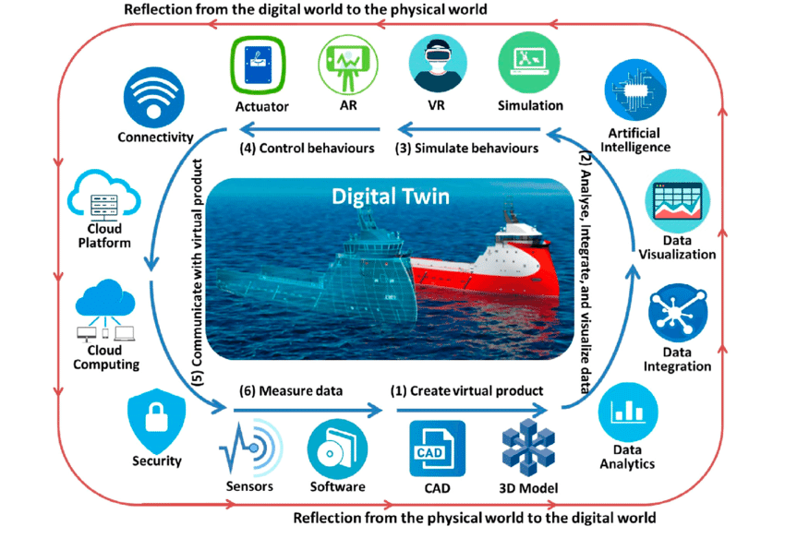
Enabling Technologies of Digital Twin
Internet of things
Artificial Intelligence and Machine Learning
3D modeling
Robotics
Data Analytics / Data Science
Cloud computing
Edge Computing
AR and VR

Slide 7
Literature Survey – Paper 1
Title: Industrial IoT lifecycle via digital twins; Arquimedes Canedo. 2016.
Conference: In Proceedings of the Eleventh IEEE/ACM/IFIP International Conference on Hardware/Software Codesign and System Synthesis (CODES '16). Association for Computing Machinery, New York, NY, USA, Article 29, 1.
Abstract:
The Digital Twin technology is moving towards creating a digital representation of a real world object with focus on the object itself. However, when every real world object (e.g., a car, a machine tool, a factory, a person) has a Digital Twin counterpart, the spatio-temporal relations between the objects’ Digital Twins become more valuable than the individual Digital Twins. Rather than locally and individually optimizing systems as it is done today, there will be major efficiency gains when the interactions between objects are optimized at a system-of-systems level.
Demerits: Systems approach of digital twin is missing.

Slide 8
Literature Survey – Paper 2
Title: "From Surveillance to Digital Twin: Challenges and Recent Advances of Signal Processing for Industrial Internet of Things,"
Authors: Y. He, J. Guo and X. Zheng,
Published in IEEE Signal Processing Magazine, vol. 35, no. 5, pp. 120-129, Sept. 2018
Abstract:
In this article, we survey the promising industrial applications of IoT technologies and discuss the challenges and recent advances in this area. We also share our early experience with Pavatar, a real-world industrial IoT system that enables comprehensive surveillance and remote diagnosis for ultrahigh-voltage converter station (UHVCS).
Demerits: The paper focuses only on one aspect of UHVCS. The same has to be extended to manufacturing industry.

Slide 9
Literature Survey – Paper 3
Title: Combination of Digital Twin and Artificial Intelligence in Manufacturing Using Industrial IoT
Authors: V. Kharchenko, O. Illiashenko, O. Morozova and S. Sokolov,
2020 IEEE 11th International Conference on Dependable Systems, Services and Technologies (DESSERT), 2020, pp. 196-201.
Abstract: The paper focuses on Digital Twin (DT) in Manufacturing using Artificial Intelligence (AI) and Industrial IoT. According to the concept, the manufacturing includes three main units: equipment, personnel and processes. All data from these units are inherited to manufacture model (DT) and decision support system with the use of AI
Demerits:
Using proprietary software which is very costly to design the digital twin.

Slide 10
Problem Statement
Digital twin is a very novel and complicated concept that involves multiple technologies.
Initially it was implemented for space technology and later extended to defence aerospace applications.
The extension of digital twins to industry also known as Industry 4.0 is challenging as it depends on use of high end simulators and proprietary software.
Objectives
To design a physical object of conveyor and robotic arm for shape base sorting.
To design a virtual object in unity software and implementing an Augmented Reality concept of the project.
To establish communication between the digital and physical object to provide bi-directional control mechanism.

Slide 11
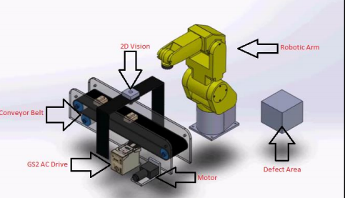
Project Block Diagram
Main Project Blocks -
Speed Controlled Conveyor Belt,
2. Camera and PC for Object recognition,
3. Robotic Arm.

Slide 12
DESIGN OF 4 DoF ROBOTIC ARM

Slide 13
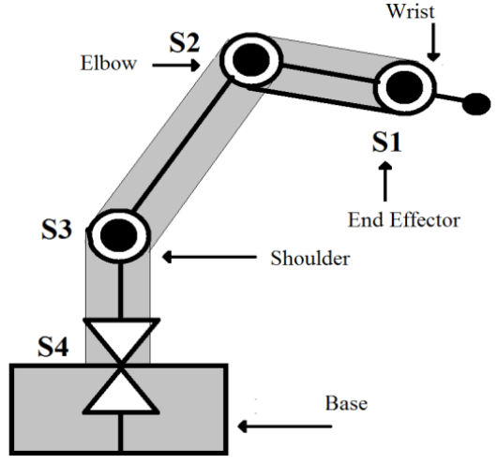
Structural diagram of 4 DoF Robotic Arm
Specification | Value
Number of Axes | 4
Horizontal reach | 230 mm
Vertical reach | 130 mm
Drives | 4 servo motors
Configuration | 4 Axes + end effector All axes are independent All axes can be controlled simultaneously
Work Envelope | Shoulder : 150 degrees Elbow: 180 degrees Wrist: 180 degrees End effector: 90 degrees

Slide 14
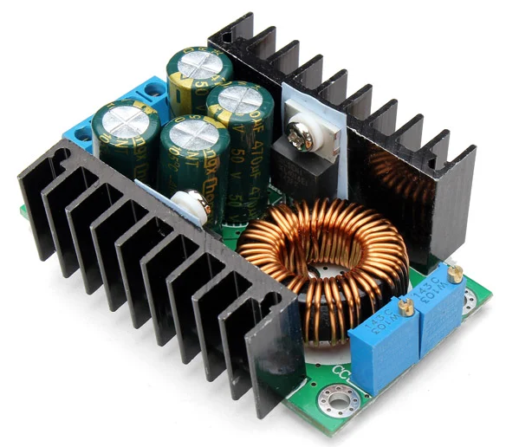

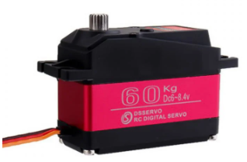
Hardware Components
Arduino UNO
DC to DC Conversion Module
Ultra Torque Servo Motor

Slide 15
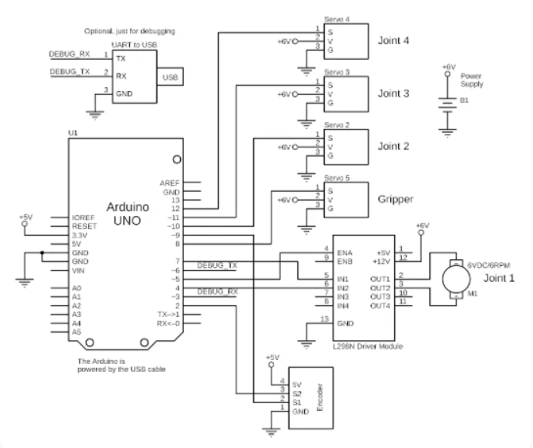
Control Circuit Design for Robotic Arm

Slide 16
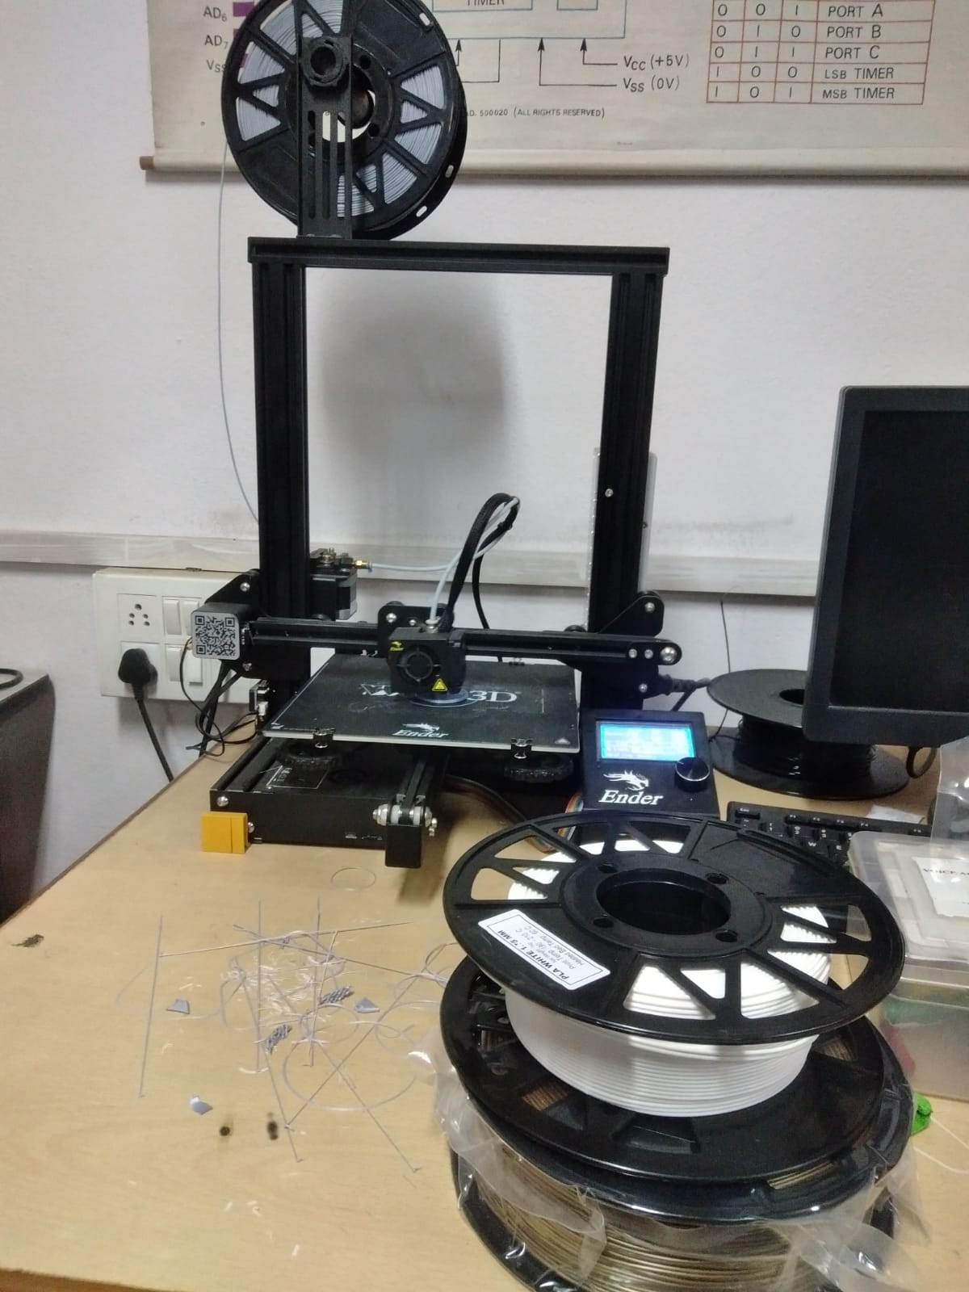
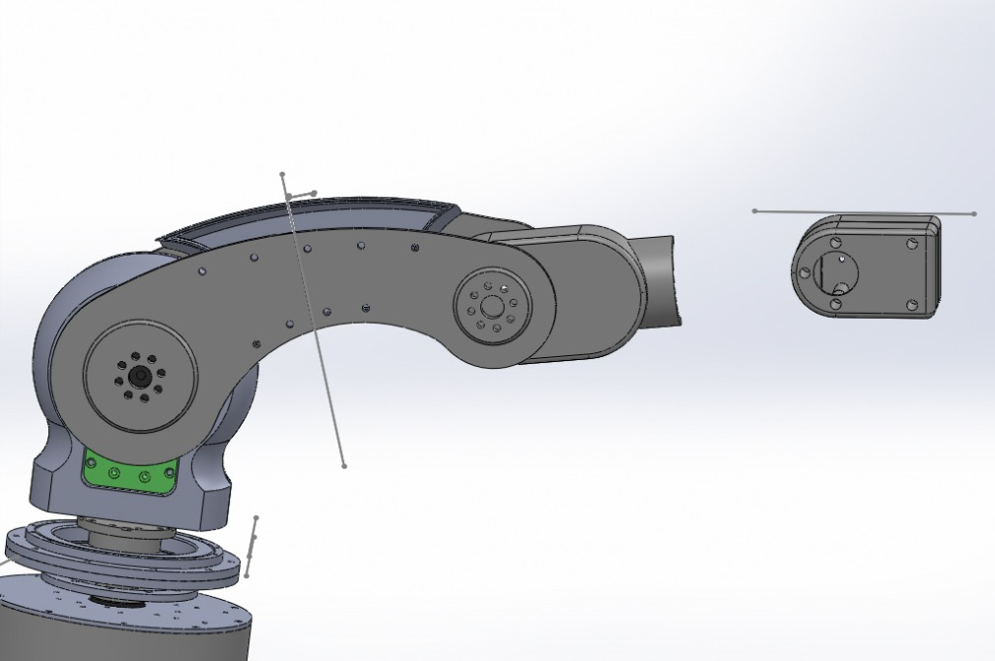
Robotic Arm Design
Design in SolidWorks
3D Printer

Slide 17
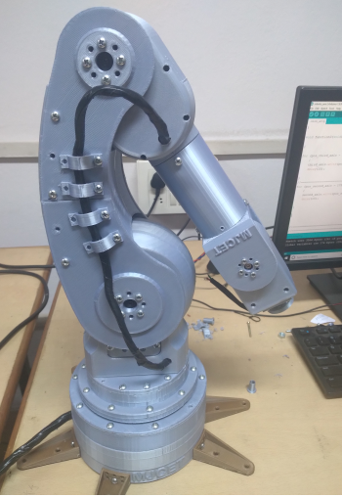
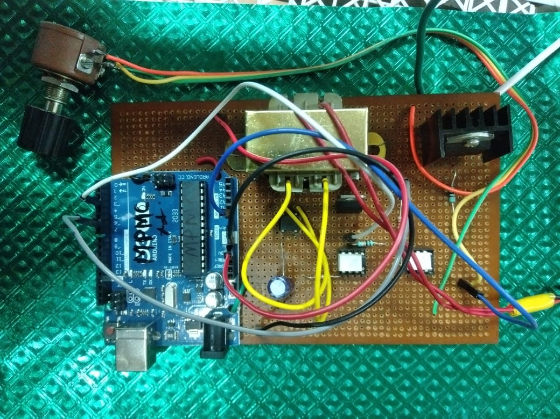
Robotic Arm Design
Circuit Design
Robotic Arm

Slide 18
DESIGN OF CONVEYOR BELT

Slide 19
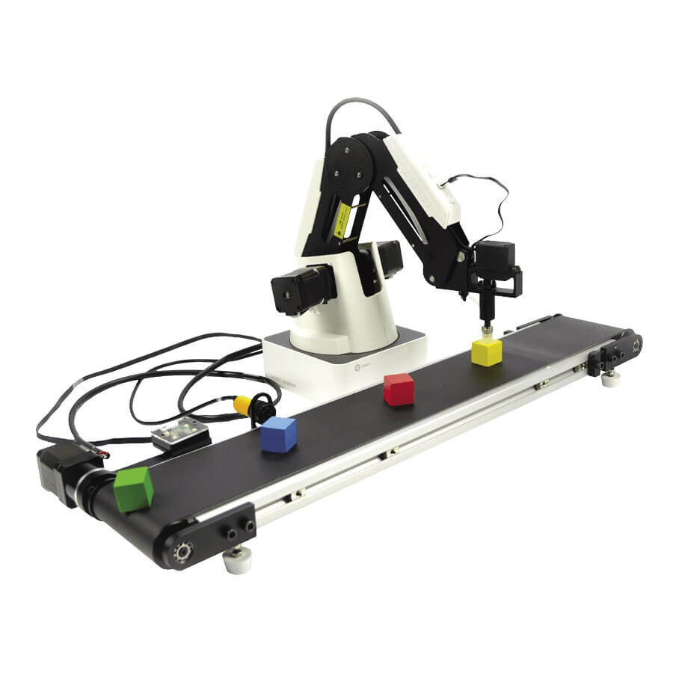
Design of IoT Controlled Conveyor Belt
C. Ulices, M. Irma and J. Carlos, "Design of an Electronic Coupling to Control Speed of Motor on a Conveyor Belt Using IoT," 2020 International Conference on Mechatronics, Electronics and Automotive Engineering (ICMEAE), 2020, pp. 115-121,
doi: 10.1109/ICMEAE51770.2020.00027.

Slide 20
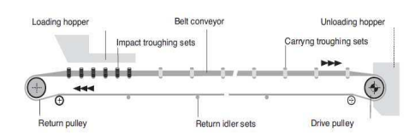
Basic Design of Conveyor belt system
Design parameters: Payload, Belt size, Motor specifications, Belt Speed, Gear Box selection, Speed Control Mechanism

Slide 21
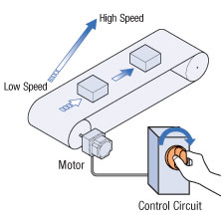
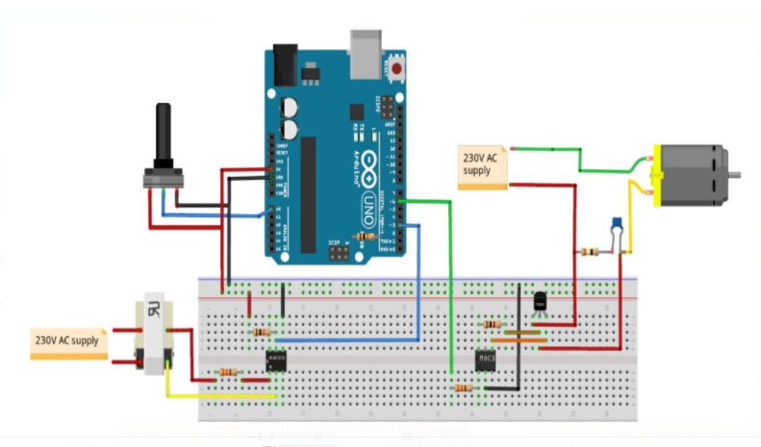
IoT Based Speed Control of Conveyor Belt
Components: Potentiometer, Optocouplers, Arduino UNO, TRIAC, Motor

Slide 22
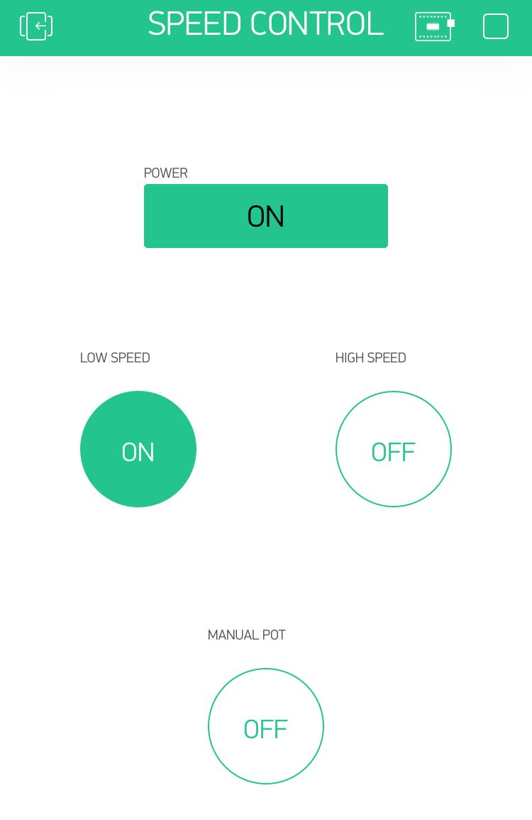
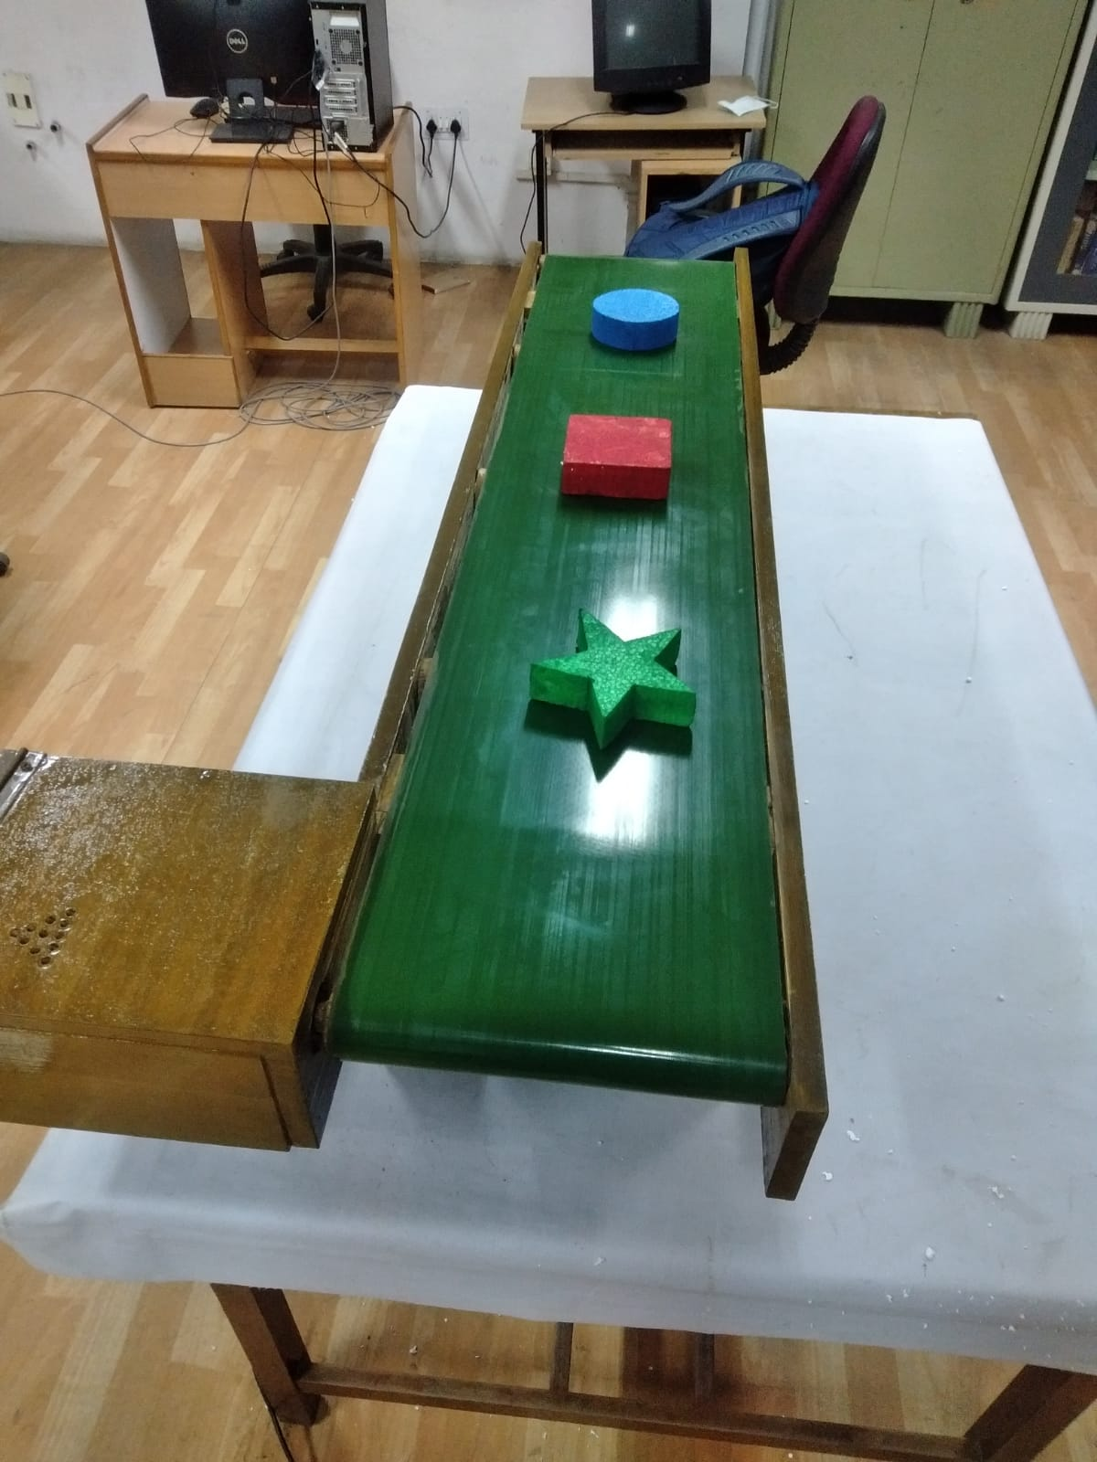
Conveyor Belt – IoT based Motor Speed Control

Slide 23
SHAPE RECOGNITION AND SORTING

Slide 24
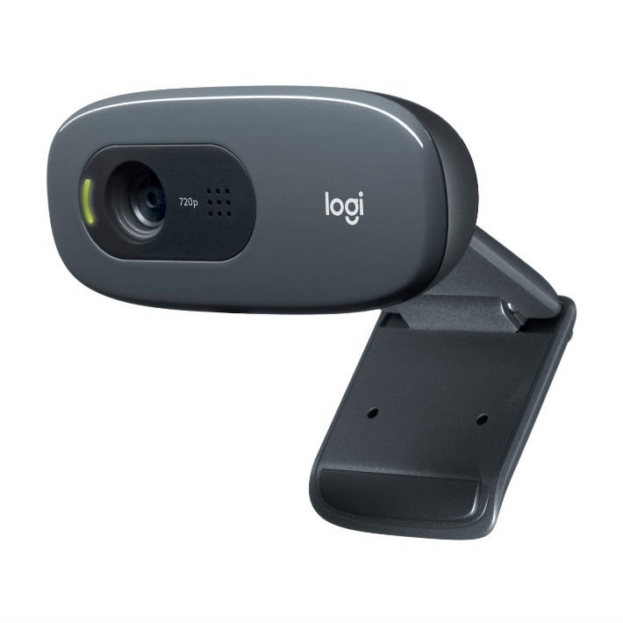
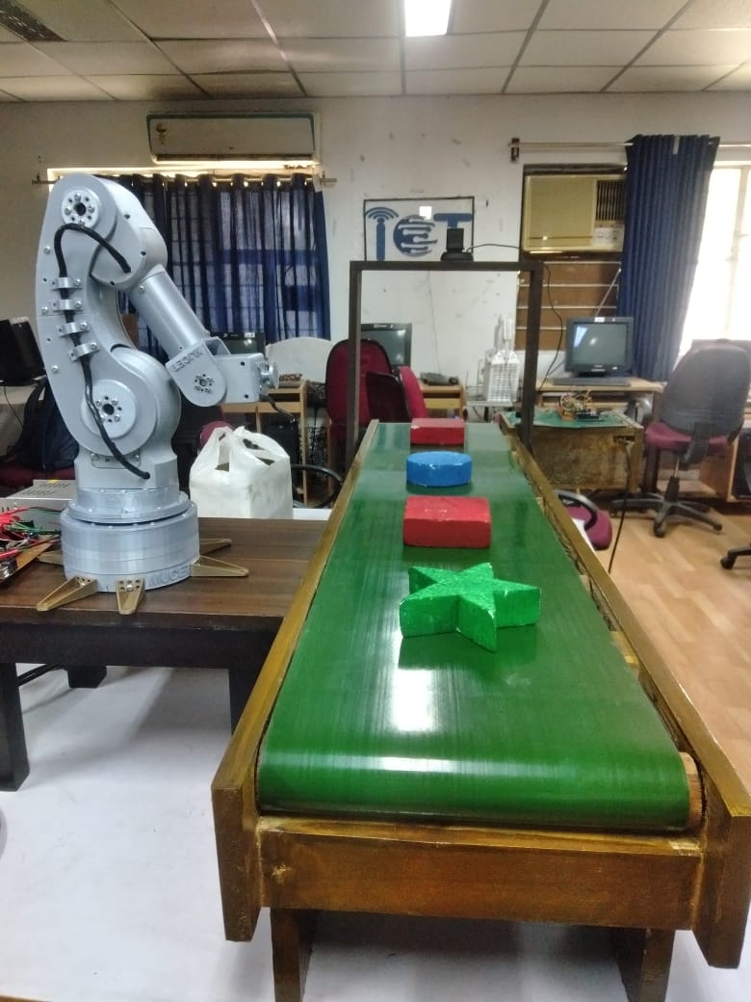
Web Camera for Object Detection

Slide 25
Dataset for Object Detection
Dataset created in JPEG format
Objects with different shapes
Square
circle\
Star
Total: 75 images
different angles
different backgrounds
different lighting conditions
Python Programming

Slide 26
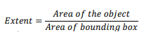
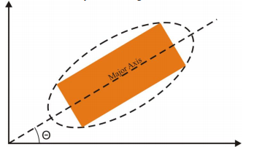
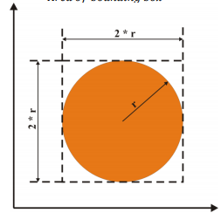
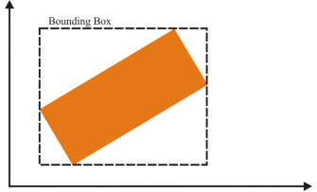
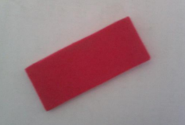
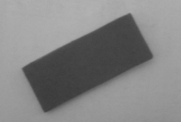
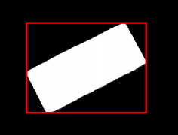
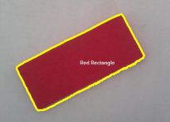

Algorithm execution

Slide 27
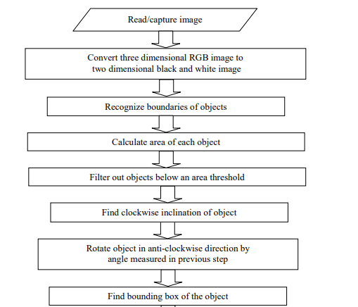
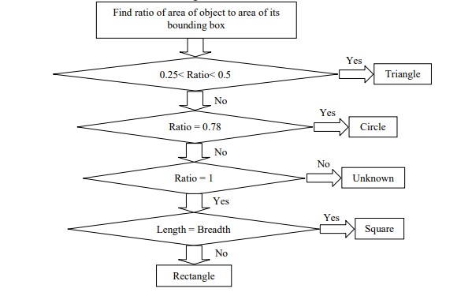
Algorithm of shape recognition
A
A

Slide 28
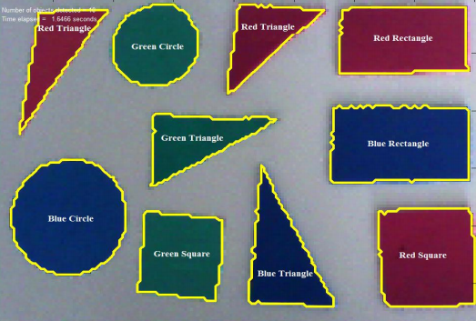
Final Result of Shape and Colour Recognition

Slide 29
OVERALL SYSTEM DESIGN

Slide 30
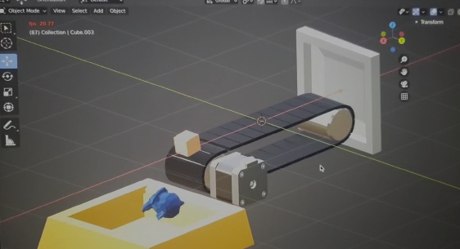
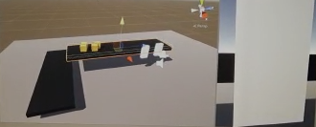
Digital Twin Design of Conveyor Belt
Design using Blender
(open-source tool)
Design using Unity 3D
(student version)
Problem: unable to control speed of motor externally
Control speed of motor externally is possible

Slide 31
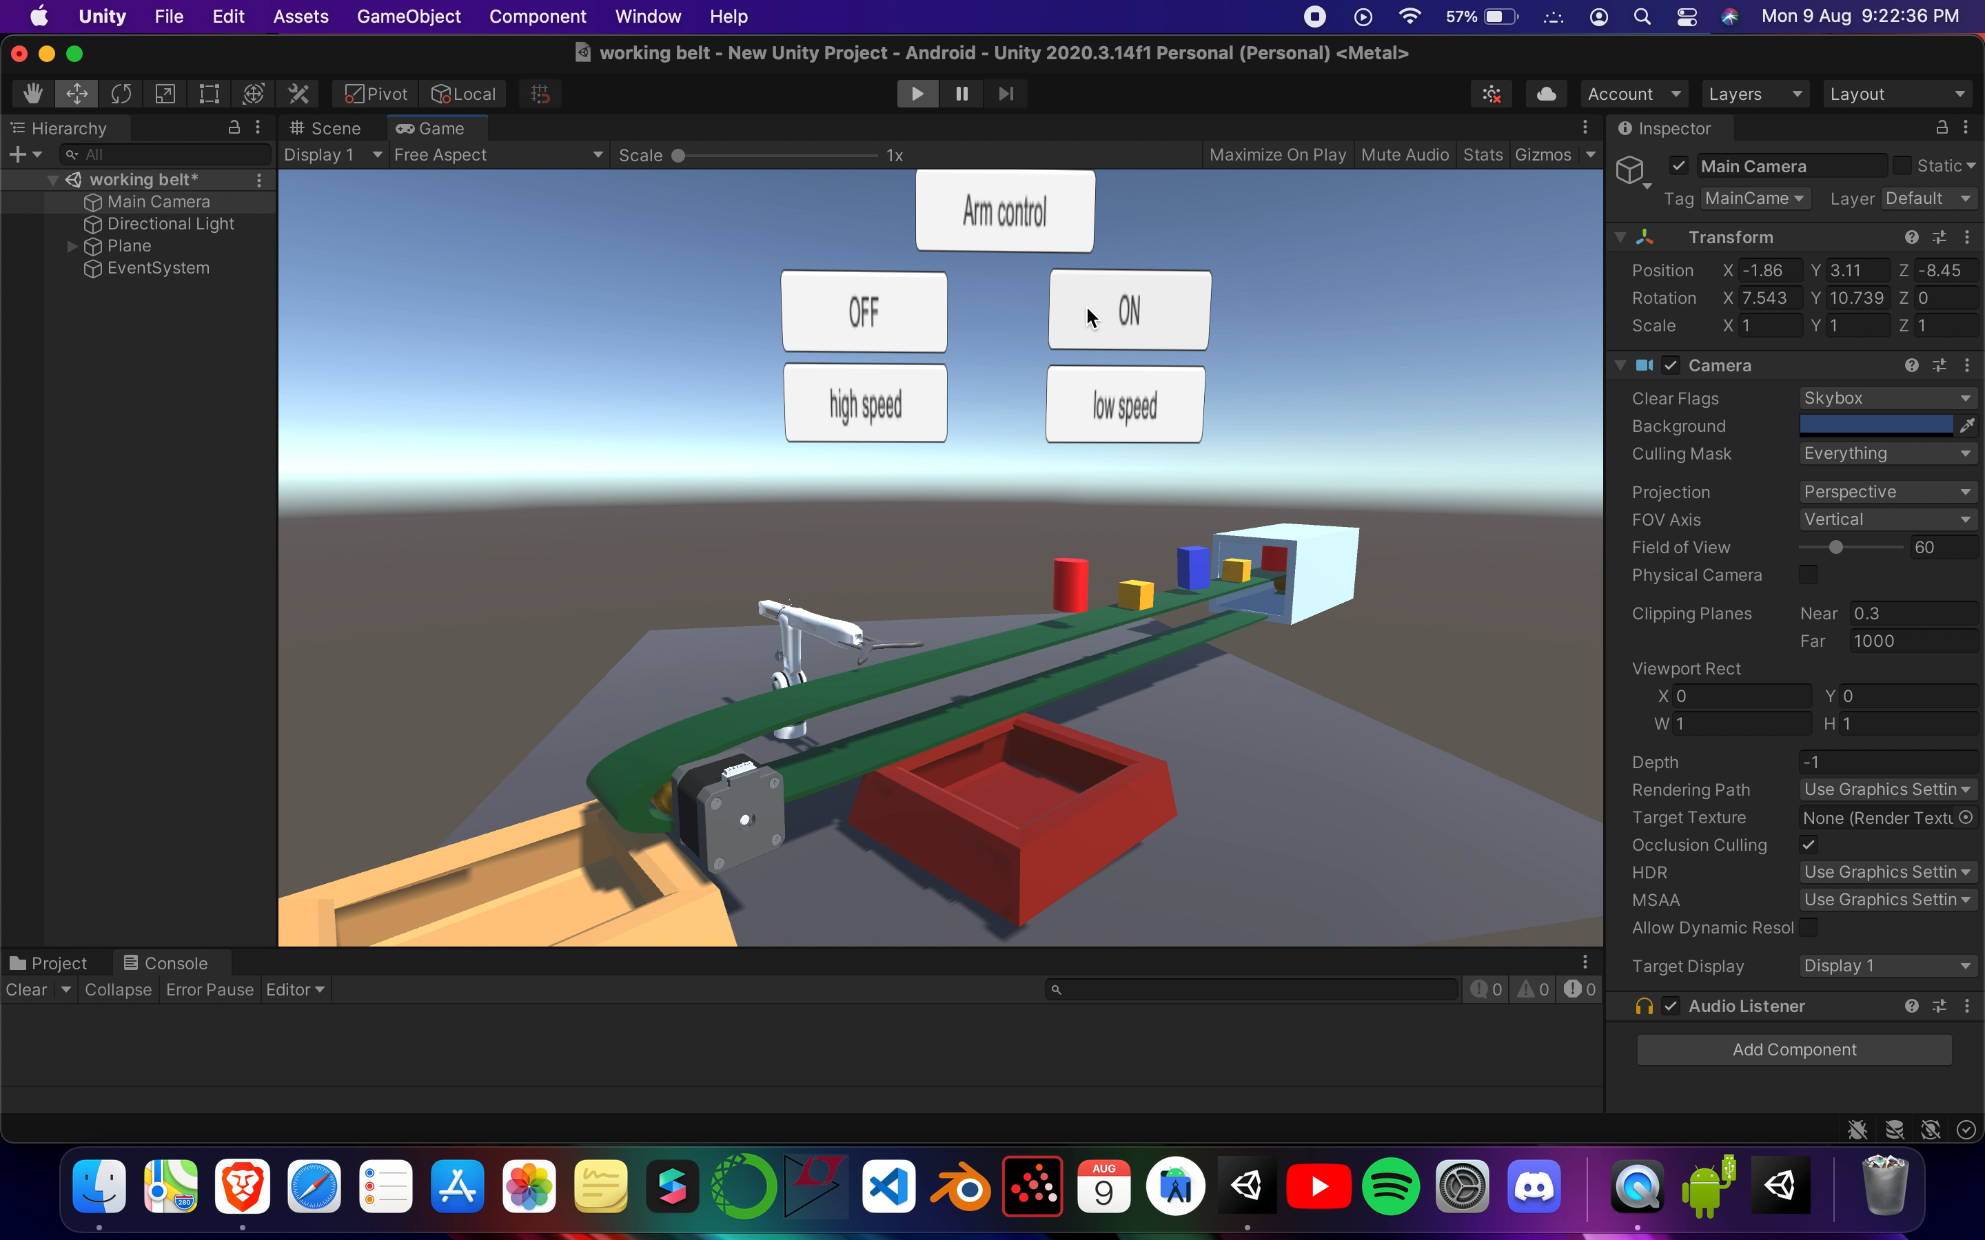
Implementation of Virtual Twin in Unity 3D Software

Slide 32
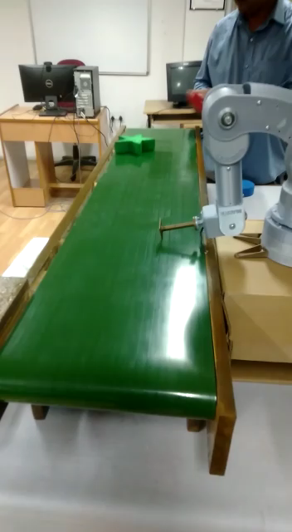
Implementation Physical Twin

Slide 33
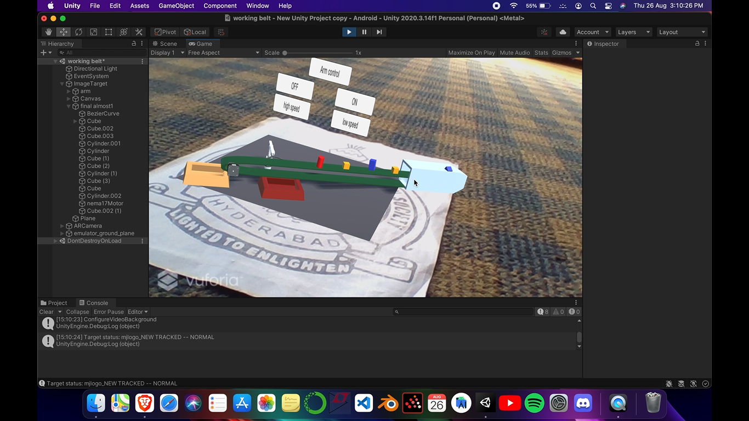
Final Implementation of Digital Twin and Physical IIoT Model

Slide 34
Conclusion and Future Scope
A physical manufacturing system used in Industries is designed. A digital twin of manufacturing system of conveyor belt and robotic arm is designed.
Future Scope:
The work can be extended to include alerts for preventive maintenance.
Data harmonization of various communication protocols like HTTP, MQTT, XMPP can be taken up
Implementation using PLC and ladder logic can be done as all industrial equipment run on PLC.

Slide 35
References
[1] K. Ashton, “That ‘Internet of Things’ Thing - RFID Journal,” RFiD J., vol. 22, no. 7, pp. 97– 114, 2009.
[2] Z. Pang et al., “Design of a terminal solution for integration of in-home health care devices and services towards the Internet-of-Things,” Enterp. Inf. Syst., vol. 9, no. 1, pp. 86–116, 2015.
[3] L. Da Xu, W. He, and S. Li, “Internet of things in industries: A survey,” IEEE Trans. Ind. Informatics, vol. 10, no. 4, pp. 2233–2243, 2014.
[4] A. Zanella, N. Bui, A. Castellani, L. Vangelista, and M. Zorzi, “Internet of things for smart cities,” IEEE Internet Things J., vol. 1, no. 1, pp. 22–32, 2014.
[5] M. Darianian and M. P. Michael, “Smart home mobile RFID-based internet-of-things systems and services,” Proc. - 2008 Int. Conf. Adv. Comput. Theory Eng. ICACTE 2008, pp. 116–120, 2008.
[6] G. Broil, M. Paolucci, M. Wagner, E. Rukzio, A. Schmidt, and H. Hußmann, “Perci: Pervasive service interaction with the internet of things,” IEEE Internet Comput., vol. 13, no. 6, pp. 74–81, 2009.

Slide 36
References
[7] Dave Evans, “How the Next Evolution of the Internet Is Changing Everything.” (2011). Available: https://www.cisco.com/c/dam/en_us/about/ac79/docs/innov/IoT_IBSG_0411FINAL.pdf
[8] H. Laaki, Y. Miche and K. Tammi, "Prototyping a Digital Twin for Real Time Remote Control Over Mobile Networks: Application of Remote Surgery," in IEEE Access, vol. 7, pp. 20325-20336, 2019, doi: 10.1109/ACCESS.2019.2897018.
[9] Urmila Karale1, Jyoti Kamble, Prof. Rupali D. Patil,“Automatic Color Based Object Sorting Using Image Processing”, in International Research Journal of Engineering and Technology (IRJET) Volume: 08 Issue
[10] Stefano Farné, Ezio Bassi, Francesco Benzi & Francesco Compagnoni,“IIoT based efficiency monitoring of a pick and place robot”, ECEEE Industrial Summer Study proceedings, 2016.
[11] Oyekan, J.; Farnsworth, M.; Hutabarat, W.; Miller, D.; Tiwari, A. Applying a 6 DoF Robotic Arm and Digital Twin to Automate Fan-Blade Reconditioning for Aerospace Maintenance, Repair, and Overhaul. Sensors 2020, 20, 4637. https://doi.org/10.3390/s20164637

Slide 37
References
[12] Y. He, J. Guo and X. Zheng, "From Surveillance to Digital Twin: Challenges and Recent Advances of Signal Processing for Industrial Internet of Things," in IEEE Signal Processing Magazine, vol. 35, no. 5, pp. 120-129, Sept. 2018, doi: 10.1109/MSP.2018.2842228.
[13] V. Kharchenko, O. Illiashenko, O. Morozova and S. Sokolov, "Combination of Digital Twin and Artificial Intelligence in Manufacturing Using Industrial IoT," 2020 IEEE 11th International Conference on Dependable Systems, Services and Technologies (DESSERT), 2020, pp. 196-201, doi: 10.1109/DESSERT50317.2020.9125038.
[14] Gabriel Fedorko, “Implementation of Industry 4.0 in the belt conveyor transport”, MATEC Web Conf. 263 01001 (2019), DOI: 10.1051/matecconf/201926301001.
[15] V. Kharchenko, O. Illiashenko, O. Morozova and S. Sokolov, "Combination of Digital Twin and Artificial Intelligence in Manufacturing Using Industrial IoT," 2020 IEEE 11th International Conference on Dependable Systems, Services and Technologies (DESSERT), 2020, pp. 196-201, doi: 10.1109/DESSERT50317.2020.9125038.

Slide 38
References
[16] Fengwei Yang, Sai Gu, "Industry 4.0, a revolution that requires technology and national strategies", Complex & Intelligent Systems (2021) 7:1311–1325
[17] Zhu, Zexuan & Liu, Chao & Xu, Xun. (2019). Visualisation of the Digital Twin data in manufacturing by using Augmented Reality. Procedia CIRP. 81. 898-903. 10.1016/j.procir.2019.03.223.
[18] Paul Milgram , Fumio Kishino , “IEICE Transactions on Information Systems”, Vol E77-D, No.12 December 1994.
[19] Michele Cohen Marill, https://www.wired.com/story/hey-surgeon-is-that-a-hololens-on-your-head/
[20] Bernard Marr, “Future Predictions Of How Virtual Reality And Augmented Reality Will Reshape Our Lives”, Available at:
https://www.forbes.com/sites/bernardmarr/2021/06/04/future-predictions-of-how-virtual-reality-and-augmented-reality-will-reshape-our-lives/

Slide 39
References
[21] G. Schroeder et al., "Visualising the digital twin using web services and augmented reality," 2016 IEEE 14th International Conference on Industrial Informatics (INDIN), 2016, pp. 522-527, doi: 10.1109/INDIN.2016.7819217.
[22] Rese, A., Baier, D., Geyer-Schulz, A., Schreiber, S., 2017. “How augmented reality apps are accepted by consumers: A comparative analysis using scales and opinions.” Technological Forecasting and Social Change 124, 306–319.
[23] Rabah, Souad & ASSILA, Ahlem & Khouri, Elio & Maier, Florian & Ababsa, Fakhreddine & bourny, Valéry & Maier, Paul & Merienne, Frédéric. (2018). Towards improving the future of manufacturing through digital twin and augmented reality technologies. Procedia Manufacturing. 17. 460-467. 10.1016/j.promfg.2018.10.070.
[24] https://unity3d.com/get-unity/download
[25] Konakalla Naga Sri Ananth, Vaitla Rakesh, Pothamsetty Kasi Visweswarao,“Design and Selecting the Proper Conveyor-Belt”, International Journal of Advanced Engineering Technology E-ISSN 0976-3945

Slide 40


